Slide 1
Summer Arts Camp
…dedicated to arts education

Slide 2
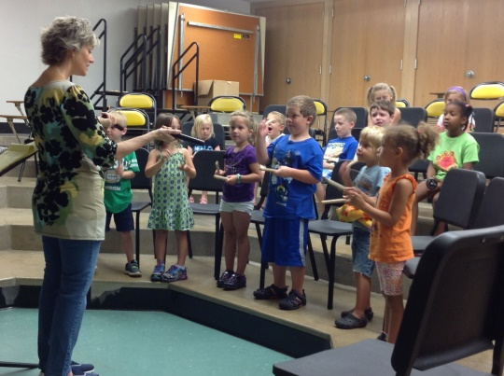
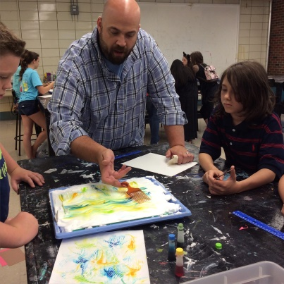
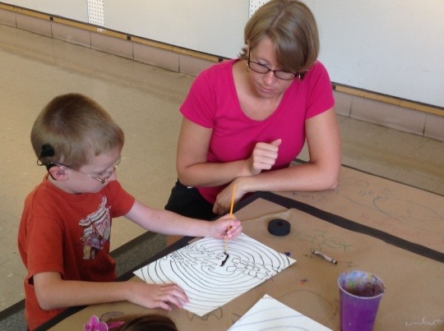
Our mission…
• Provide an arts education in a safe and nurturing environment
• Inspire individual creativity and arts ability
• Expose West Virginia youth to various genres of visual and performing arts
• Offer experiences in team building with young people from different backgrounds
• Create an accepting atmosphere for children with disabilities
• Present the opportunity to make new friends with similar interests
• Give young people tools to become critical thinkers and problem-solvers
• Spark a realization of individual talent
• Enrich the lives of children who have less access to an arts education
• Build self-esteem and enhance interpersonal growth
• Offer tools that will teach our young people how to utilize the arts as a form of communication & individual expression
• Provide an opportunity for local artists to make a living within their own community
• Help to develop future artists and arts advocates
• Provide a fun summer camp experience for our campers

Slide 3
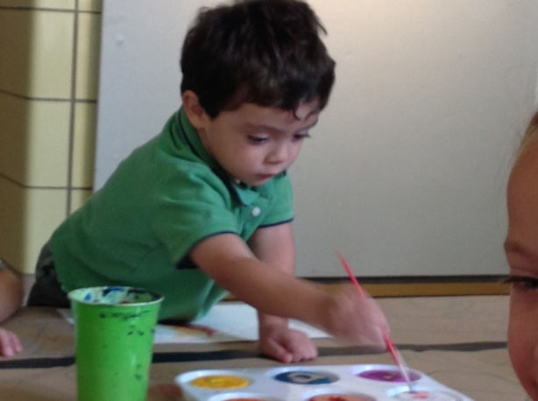
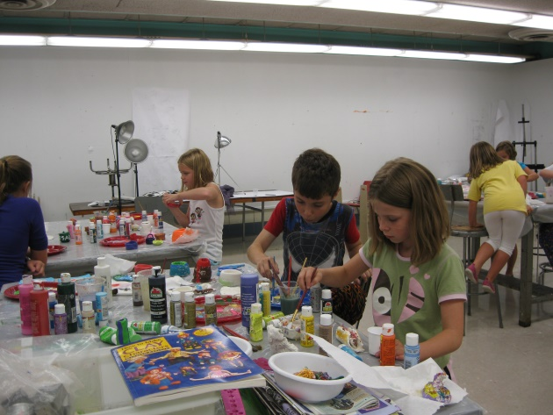
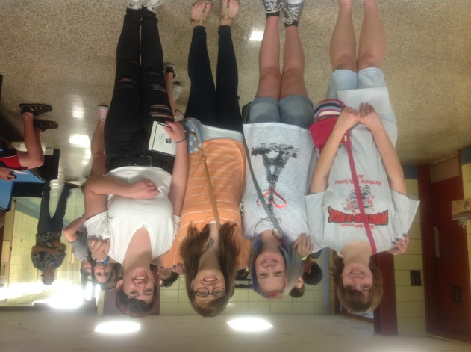
Who we are…
A two week educational visual and performing arts camp, offering instruction to beginner through advanced students ages preschool to 18 years of age.

Slide 4
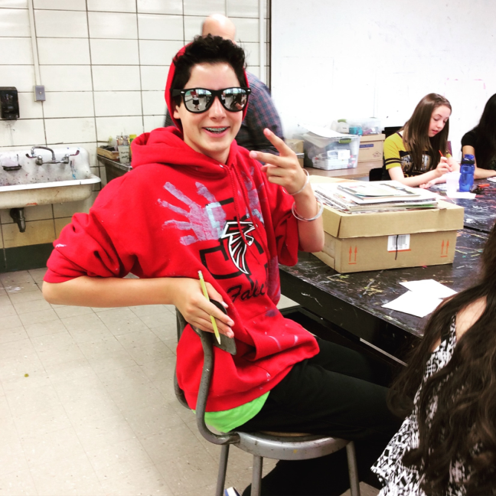
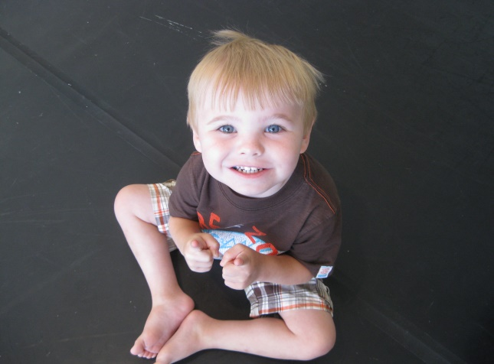
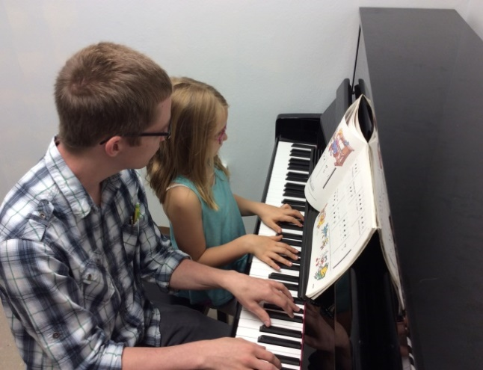
Why us…
• Emphasis is put on the process (the skills learned) rather
than just the result (the show or finished product), giving
attention to the educational aspect of art
• Junior and Senior classes are all elective thus campers are not
placed in classes that they do not wish to participate in
• Ratios of adult to camper are kept low for the safety and
individual attention of campers
• Parking is safe and convenient
• Camps are held in a facility dedicated to arts education
• Campers are exposed to many artists, giving them a broad
perspective of the arts
• Guidance is provided to help further campers' arts
education after camp has ended and throughout the year

Slide 5
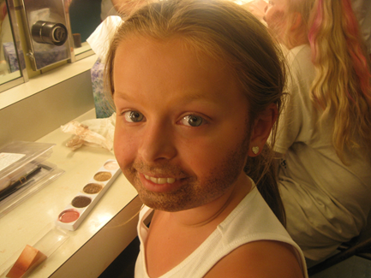
Theatre and Acting
Some classes we have that are related to this art are stage combat, script writing, stage makeup, improvisation, etc.
“Acting is the ability to dream on cue.”
-Andrei Tarkovsky

Slide 6
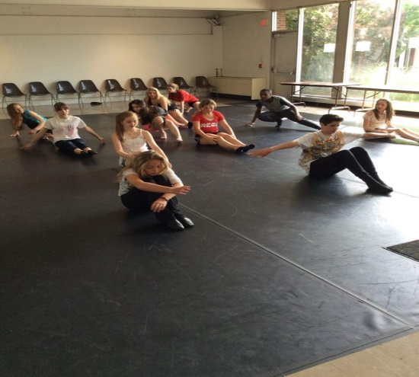
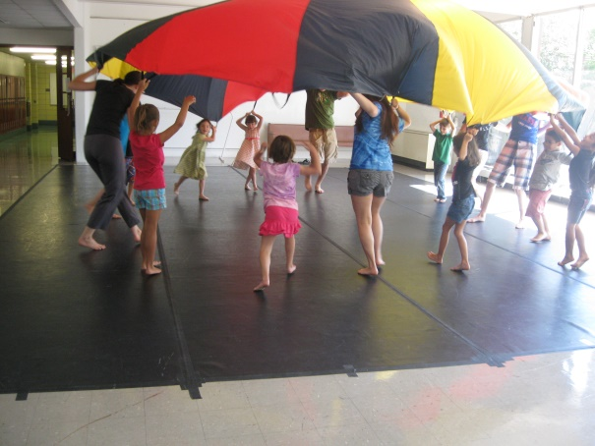
Dance
Some classes we have that are related to this art is tap, hip hop, choreography, ballet, etc.
“Dancing is like dreaming with your feet."
― Constanze

Slide 7
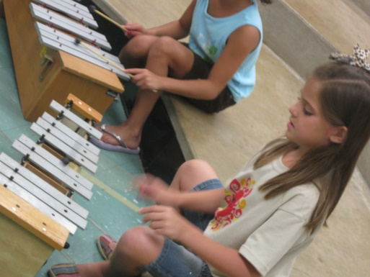
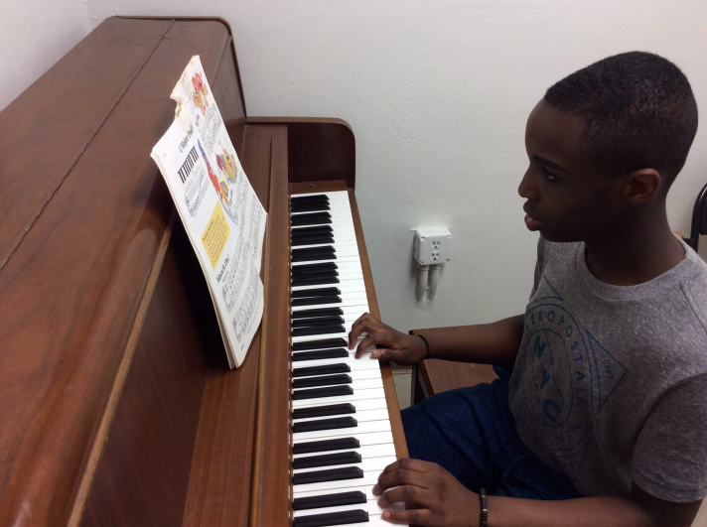
Music
Some classes that we have that are related to this art are songwriting, musical jam, music theory, vocal technique, drums and percussion, etc.
“A painter paints pictures on canvas. But musicians paint their pictures on silence.”
~Leopold Stokowski

Slide 8
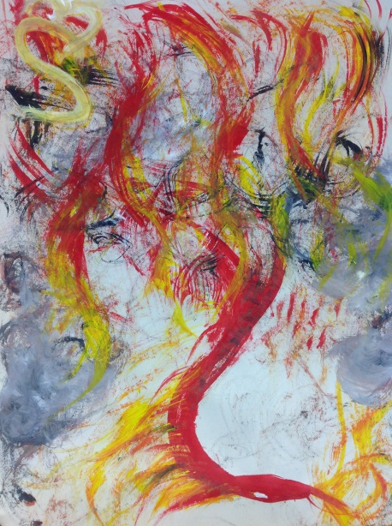
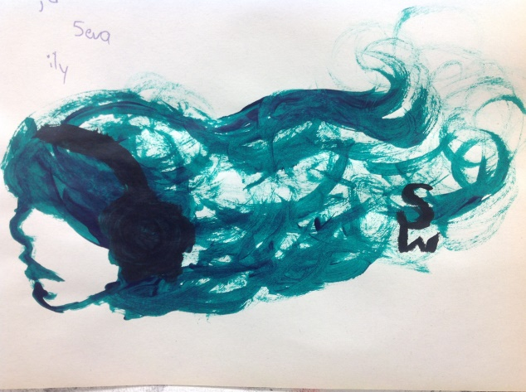
Visual Art
Some classes that are related to this art are photography, pottery, drawing, painting, animation, etc.
“The purpose of art is washing the dust of daily life off our souls.”
-Pablo Picasso

Slide 9
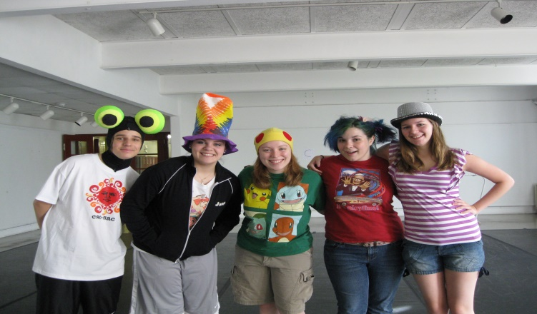
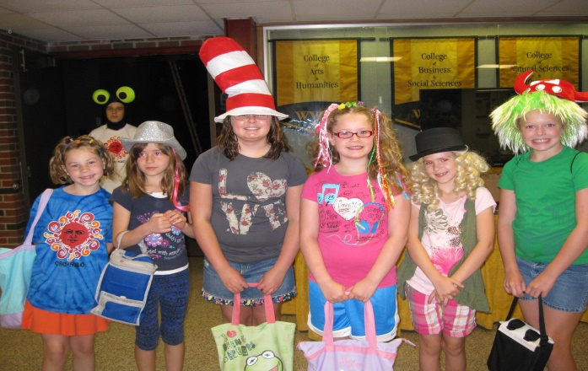
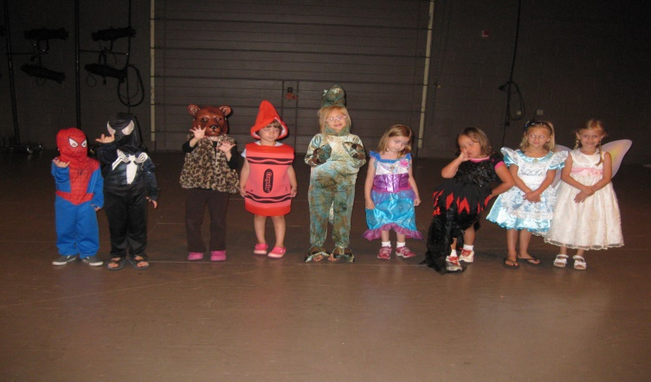
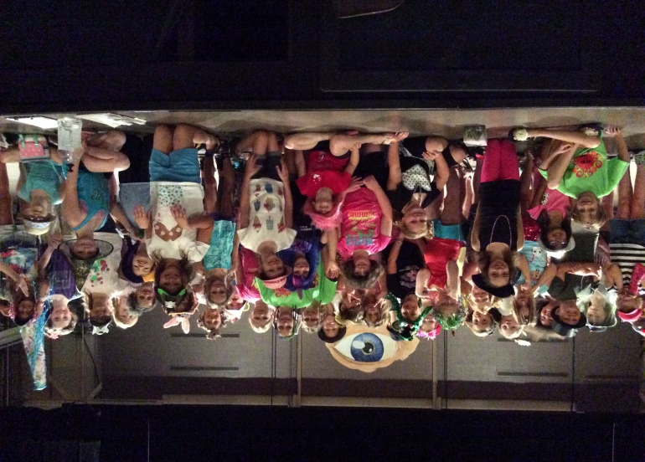
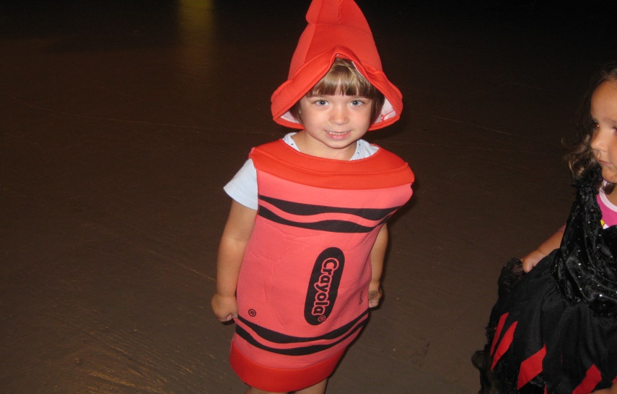
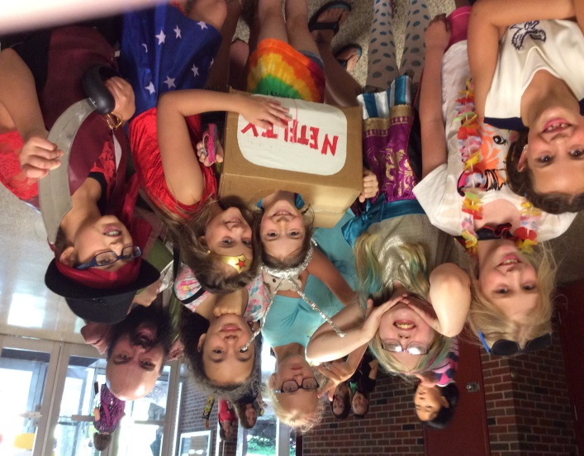
We participate in a number of themed days like crazy hat and hair day, costume day, inside-out day, etc.

Slide 10
Video showcase
The camp culminates an a showcase for the performing arts and an art exhibit for the visual arts. A video link will be provided for parents to watch their children.

Slide 11
For more information contact…
Jamie Roumayah – Owner & Director
Cell: (304)-562-6657
E-mail: wvsummerartscamp@gmail.com
Facebook: https://www.facebook.com/WVSAC
Instagram: wvsummerartscamp
Website: www.wvsummerartscamp.com

